Slide 8
Example Methods
Can add a method declaration with a structured type.
method ageOnDate (onDate date)
returns interval year
Method body is given separately.
create instance method ageOnDate (onDate date)
returns interval year
for CustomerType
begin
return onDate - self.dateOfBirth;
end
We can now find the age of each customer:
select name.lastname, ageOnDate (current_date)
from customer

Slide 9
Example Type Inheritance
Suppose that we have the following type definition for people:
create type Person (name varchar(20), address varchar(20))
Using inheritance to define the student and teacher types create type Student under Person (degree varchar(20), department varchar(20)) create type Teacher under Person (salary integer, department varchar(20))
Subtypes can redefine methods by using overriding method in place of method in the method declaration

Slide 10
TABLE INHERITANCE EXAMPLE
A car-rental company maintains a vehicle database for all vehicles in its current
fleet. For all vehicles, it includes the vehicle identification number, license number, manufacturer, model, date of purchase, and color. Special data are included
for certain types of vehicles:
• Trucks: cargo capacity
• Sports cars: horsepower, renter age requirement
• Vans: number of passengers
• Off-road vehicles: ground clearance, drivetrain (four- or two-wheel drive)
Construct an SQL:1999 schema definition for this database. Use inheritance where appropriate.

Slide 11
Answer: For this problem, we use table inheritance. We assume that MyDate,Color and DriveTrainType are pre-defined types.
create type Vehicle
(vehicle-id integer,
license-number char(15),
model char(30),
purchase-date MyDate,
color Color)manufacturer char(30),
create table vehicle of type Vehicle
create table truck
(cargo-capacity integer)
under vehicle

Slide 12
create table sportsCar
(horsepower integer
renter-age-requirement integer)
under vehicle
create table van
(num-passengers integer)
under vehicle
create table offRoadVehicle
(ground-clearance real
driveTrain DriveTrainType)
under vehicle

Slide 24
NEW CHALLENGES IN IMPLEMENTING ORDBMS
Storage and Access Methods:
Large ADTs, like BLOBs, require special storage, typically in
a different location on disk from the tuples that contain them.
• Disk-based pointers are maintained from the tuples to the
objects they contain.
• Flexible disk layout mechanisms are required for structured
objects
• A complication arises with array types. Arrays are broken
into contiguous chunks, which are then stored in some order
on disk.

Slide 25
Indexing New Types:
Users can be allowed for efficient access via indexes.
• It provides efficient indexes for ADT methods and
operators on structured objects.
• Template index structure – The Generalized Search
Tree(GiST) – allows most of the tree index structures
invented so far to be implemented with only a few lines of
user-defined ADT code.

Slide 26
QUERY PROCESSING:
User-defined aggregation functions:
To register an aggregation function, a user must implement three methods, which we call initialize, iterate and terminate.
Method Security:
ADTs give users the power to add code to the DBMS;
this power can be abused.
A buggy or malicious ADT method can bring down the
database server or even corrupt the database.
One mechanism to prevent problems is to have the user
methods be interpreted rather than compiled.
Typical interpreted languages for this purpose include
Java and the procedural portions of SQL:1999.
An alternate mechanism is to allow user methods to be
compiled from a general-purpose programming language, such as C++.

Slide 27
Physical design and efficiency issues
Query processing
User defined aggregate functions (SQL defined may not be useful)
ORDBMS allows registering new aggregate functions
Security – external methods of ADT’s – can compromise the database or crash (if its buggy).
One solution – interpreted rather than compiled (Java and procedural portions of SQL:1999).
Run in different address space than the DBMS
Method Caching
Cache of input and output of methods
Pointer Swizzling
Technique to reduce cost of cached object

Slide 28
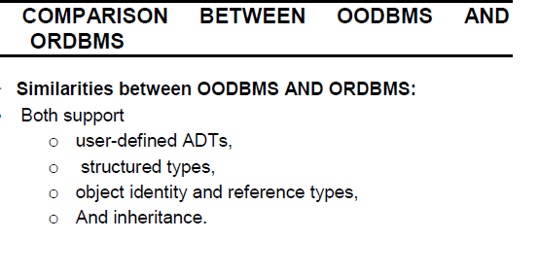
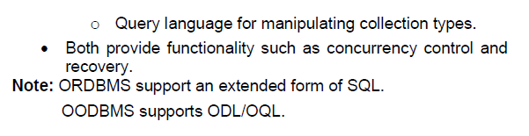

Slide 29
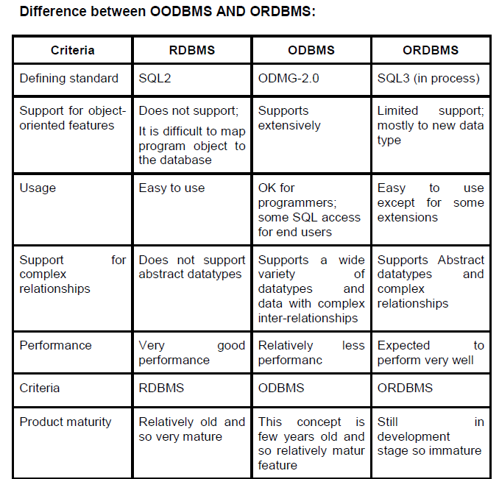

Slide 30
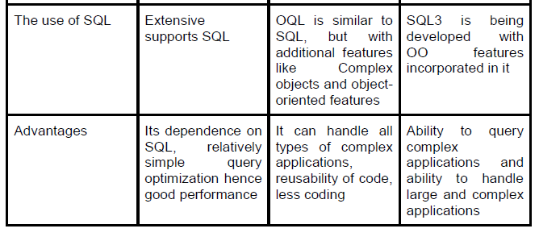
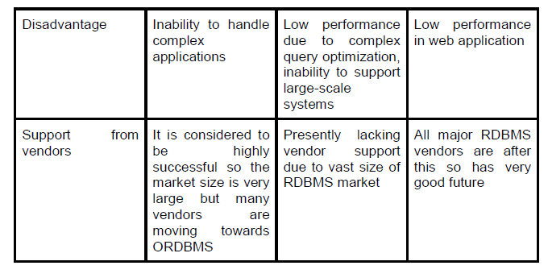

Slide 32
Chapter Outline
20.1 Overview of O-O Concepts
20.2 O-O Identity, Object Structure and Type Constructors
20.3 Encapsulation of Operations, Methods and Persistence
20.4 Type and Class Hierarchies and Inheritance
20.5 Complex Objects
20.6 Other O-O Concepts
20.7 Summary & Current Status

Slide 33
Introduction
Traditional Data Models : Hierarchical, Network (since mid-60’s), Relational (since 1970 and commercially since 1982)
Object Oriented (OO) Data Models since mid-90’s
Reasons for creation of Object Oriented Databases
Need for more complex applications
Need for additional data modeling features
Increased use of object-oriented programming languages
Commercial OO Database products – several in the 1990’s, but did not make much impact on mainstream data management

Slide 34
History of OO Models and Systems
Languages: Simula (1960’s), Smalltalk (1970’s), C++ (late 1980’s), Java (1990’s)
Experimental Systems: Orion at MCC, IRIS at H-P labs, Open-OODB at T.I., ODE at ATT Bell labs, Postgres - Montage - Illustra at UC/B, Encore/Observer at Brown
Commercial OO Database products: Ontos, Gemstone, O2 ( -> Ardent), Objectivity, Objectstore ( -> Excelon), Versant, Poet, Jasmine (Fujitsu – GM)

Slide 35
20.1 Overview of Object-Oriented Concepts(1)
MAIN CLAIM: OO databases try to maintain a direct correspondence between real-world and database objects so that objects do not lose their integrity and identity and can easily be identified and operated upon
Object: Two components: state (value) and behavior (operations). Similar to program variable in programming language, except that it will typically have a complex data structure as well as specific operations defined by the programmer

Slide 36
Overview of Object-Oriented Concepts (2)
In OO databases, objects may have an object structure of arbitrary complexity in order to contain all of the necessary information that describes the object.
In contrast, in traditional database systems, information about a complex object is often scattered over many relations or records, leading to loss of direct correspondence between a real-world object and its database representation.

Slide 37
Overview of Object-Oriented Concepts (3)
The internal structure of an object in OOPLs includes the specification of instance variables, which hold the values that define the internal state of the object.
An instance variable is similar to the concept of an attribute, except that instance variables may be encapsulated within the object and thus are not necessarily visible to external users

Slide 38
Overview of Object-Oriented Concepts (4)
Some OO models insist that all operations a user can apply to an object must be predefined. This forces a complete encapsulation of objects.
To encourage encapsulation, an operation is defined in two parts:
signature or interface of the operation, specifies the operation name and arguments (or parameters).
method or body, specifies the implementation of the operation.

Slide 39
Overview of Object-Oriented Concepts (5)
Operations can be invoked by passing a message to an object, which includes the operation name and the parameters. The object then executes the method for that operation.
This encapsulation permits modification of the internal structure of an object, as well as the implementation of its operations, without the need to disturb the external programs that invoke these operations

Slide 40
Overview of Object-Oriented Concepts (6)
Some OO systems provide capabilities for dealing with multiple versions of the same object (a feature that is essential in design and engineering applications).
For example, an old version of an object that represents a tested and verified design should be retained until the new version is tested and verified:
very crucial for designs in manufacturing process control, architecture , software systems …..

Slide 41
Overview of Object-Oriented Concepts (7)
Operator polymorphism: It refers to an operation’s ability to be applied to different types of objects; in such a situation, an operation name may refer to several distinct implementations, depending on the type of objects it is applied to.
This feature is also called operator overloading

Slide 42
20.2 Object Identity, Object Structure, and Type Constructors (1)
Unique Identity: An OO database system provides a unique identity to each independent object stored in the database. This unique identity is typically implemented via a unique, system-generated object identifier, or OID
The main property required of an OID is that it be immutable; that is, the OID value of a particular object should not change. This preserves the identity of the real-world object being represented.

Slide 43
Object Identity, Object Structure, and Type Constructors (2)
Type Constructors: In OO databases, the state (current value) of a complex object may be constructed from other objects (or other values) by using certain type constructors.
The three most basic constructors are atom, tuple, and set. Other commonly used constructors include list, bag, and array. The atom constructor is used to represent all basic atomic values, such as integers, real numbers, character strings, Booleans, and any other basic data types that the system supports directly.

Slide 44
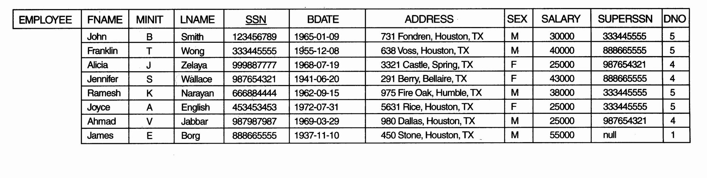
Object Identity, Object Structure, and Type Constructors (3)
Example 1, one possible relational database state corresponding to COMPANY schema

Slide 45
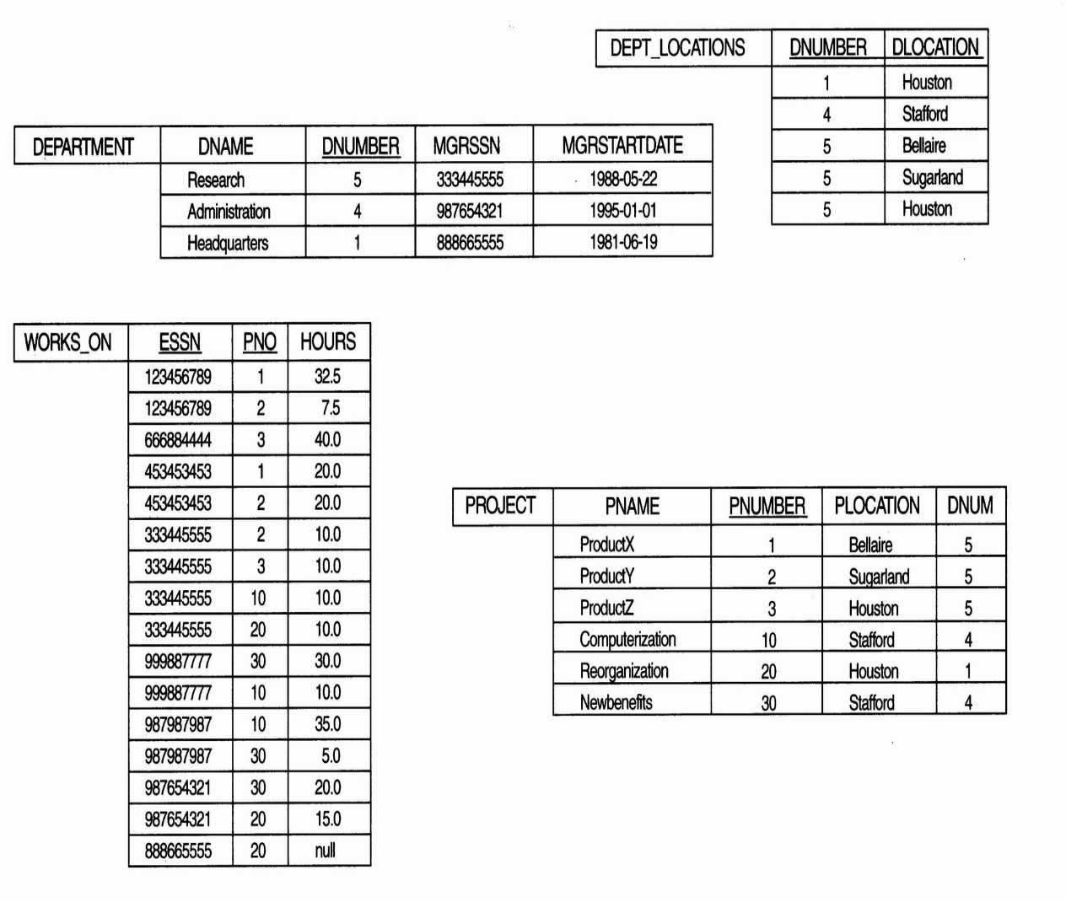
Object Identity, Object Structure, and Type Constructors (4)
Example 1 (cont.):

Slide 46
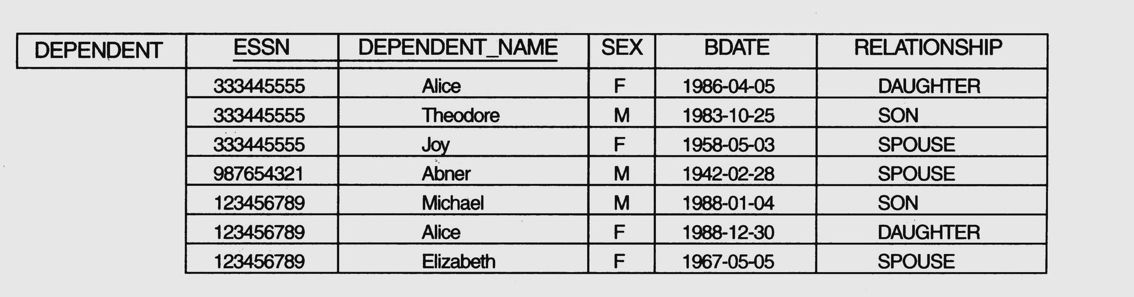
Object Identity, Object Structure, and Type Constructors (5)
Example 1 (cont.)

Slide 47
Object Identity, Object Structure, and Type Constructors (6)
Example 1 (cont.)
We use i₁, i₂, i₃, . . . to stand for unique system-generated object identifiers. Consider the following objects:
o₁ = (i₁, atom, ‘Houston’)
o₂ = (i₂, atom, ‘Bellaire’)
o₃ = (i₃, atom, ‘Sugarland’) o₄ = (i₄, atom, 5)
o₅ = (i₅, atom, ‘Research’)
o₆ = (i₆, atom, ‘1988-05-22’)
o₇ = (i₇, set, {i₁, i₂, i₃})

Slide 48
Object Identity, Object Structure, and Type Constructors (7)
Example 1(cont.)
o₈ = (i₈, tuple, <dname:i₅, dnumber:i₄, mgr:i₉, locations:i₇, employees:i₁₀, projects:i₁₁>)
o₉ = (i₉, tuple, <manager:i₁₂, manager_start_date:i₆>)
o₁₀ = (i₁₀, set, {i₁₂, i₁₃, i₁₄})
o₁₁ = (i₁₁, set {i₁₅, i₁₆, i₁₇})
o₁₂ = (i₁₂, tuple, <fname:i₁₈, minit:i₁₉, lname:i₂₀, ssn:i₂₁, . . ., salary:i₂₆, supervi­sor:i₂₇, dept:i₈>)
. . .

Slide 49
Object Identity, Object Structure, and Type Constructors (8)
Example 1 (cont.)
The first six objects listed in this example represent atomic values. Object seven is a set-valued object that represents the set of locations for department 5; the set refers to the atomic objects with values {‘Houston’, ‘Bellaire’, ‘Sugarland’}. Object 8 is a tuple-valued object that represents department 5 itself, and has the attributes DNAME, DNUMBER, MGR, LOCATIONS, and so on.

Slide 50
Object Identity, Object Structure, and Type Constructors (9)
Example 2:
This example illustrates the difference between the two definitions for comparing object states for equality.
o₁ = (i₁, tuple, <a₁:i₄, a₂:i₆>)
o₂ = (i₂, tuple, <a₁:i₅, a₂:i₆>)
o₃ = (i₃, tuple, <a₁:i₄, a₂:i₆>)
o₄ = (i₄, atom, 10)
o₅ = (i₅, atom, 10)
o₆ = (i₆, atom, 20)

Slide 51
Object Identity, Object Structure, and Type Constructors (10)
Example 2 (cont.):
In this example, The objects o₁ and o₂ have equal states, since their states at the atomic level are the same but the values are reached through distinct objects o₄ and o₅.
However, the states of objects o₁ and o₃ are identical, even though the objects themselves are not because they have distinct OIDs. Similarly, although the states of o₄ and o₅ are identical, the actual objects o₄ and o₅ are equal but not identical, because they have distinct OIDs.

Slide 52
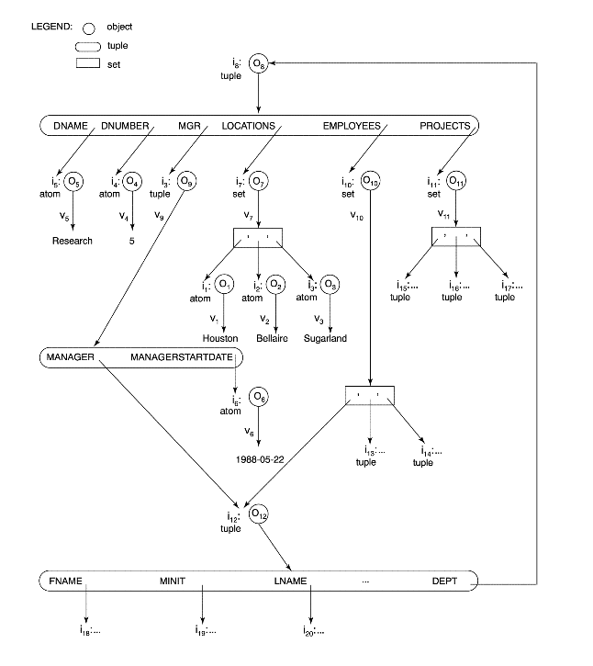
Object Identity, Object Structure, and Type Constructors (11)
Figure 20.1 Representation of a DEPARTMENT complex object as a graph

Slide 53
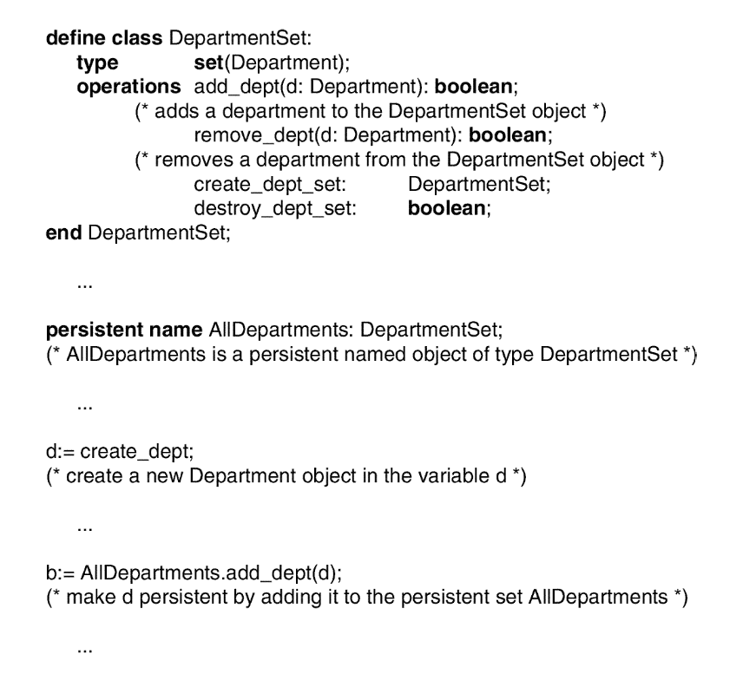
Encapsulation of Operations, Methods, and Persistence (4)
Figure 20.3 Adding operations to definitions of Employee and Department

Slide 54
Encapsulation of Operations, Methods, and Persistence (5)
Specifying Object Persistence via Naming and Reachability:
Naming Mechanism: Assign an object a unique persistent name through which it can be retrieved by this and other programs.
Reachability Mechanism: Make the object reachable from some persistent object.
An object B is said to be reachable from an object A if a sequence of references in the object graph lead from object A to object B.

Slide 55
Encapsulation of Operations, Methods, and Persistence (6)
Specifying Object Persistence via Naming and Reachability (cont.):
In traditional database models such as relational model or EER model, all objects are assumed to be persistent.
In OO approach, a class declaration specifies only the type and operations for a class of objects. The user must separately define a persistent object of type set (DepartmentSet) or list (DepartmentList) whose value is the collection of references to all persistent DEPARTMENT objects

Slide 56
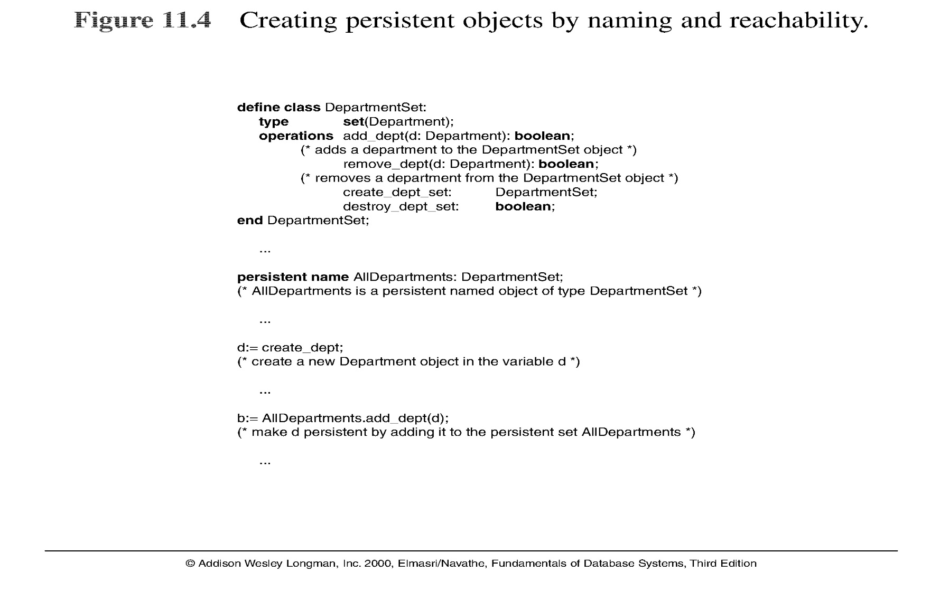
Encapsulation of Operations, Methods, and Persistence (7)
Note: The above figure is now called Figure 20.4 in Edition 4

Slide 57
20.4 Type and Class Hierarchies and Inheritance (1)
Type (class) Hierarchy
A type in its simplest form can be defined by giving it a type name and then listing the names of its visible (public) functions
When specifying a type in this section, we use the following format, which does not specify arguments of functions, to simplify the discussion:
TYPE_NAME: function, function, . . . , function
Example:
PERSON: Name, Address, Birthdate, Age, SSN

Slide 58
Type and Class Hierarchies and Inheritance (2)
Subtype: when the designer or user must create a new type that is similar but not identical to an already defined type
Supertype: It inherits all the functions of the subtype

Slide 59
Type and Class Hierarchies and Inheritance (3)
Example (1):
EMPLOYEE: Name, Address, Birthdate, Age, SSN, Salary, HireDate, Seniority
STUDENT: Name, Address, Birthdate, Age, SSN, Major, GPA
OR:
EMPLOYEE subtype-of PERSON: Salary, HireDate, Seniority
STUDENT subtype-of PERSON: Major, GPA

Slide 60
Type and Class Hierarchies and Inheritance (4)
Example (2):
Consider a type that describes objects in plane geometry, which may be defined as follows:
GEOMETRY_OBJECT: Shape, Area, ReferencePoint

Slide 61
Type and Class Hierarchies and Inheritance (5)
Example (2) (cont.):
Now suppose that we want to define a number of subtypes for the GEOMETRY_OBJECT type, as follows:
RECTANGLE subtype-of GEOMETRY_OBJECT: Width, Height
TRIANGLE subtype-of GEOMETRY_OBJECT:
Side1, Side2, Angle
CIRCLE subtype-of GEOMETRY_OBJECT: Radius

Slide 62
Type and Class Hierarchies and Inheritance (6)
Example (2) (cont.):
An alternative way of declaring these three subtypes is to specify the value of the Shape attribute as a condition that must be satisfied for objects of each subtype:
RECTANGLE subtype-of GEOMETRY_OBJECT (Shape=‘rectangle’): Width, Height
TRIANGLE subtype-of GEOMETRY_OBJECT (Shape=‘triangle’): Side1, Side2, Angle
CIRCLE subtype-of GEOMETRY_OBJECT (Shape=‘circle’): Radius

Slide 63
Type and Class Hierarchies and Inheritance (7)
Extents: In most OO databases, the collection of objects in an extent has the same type or class. However, since the majority of OO databases support types, we assume that extents are collections of objects of the same type for the remainder of this section.
Persistent Collection: It holds a collection of objects that is stored permanently in the database and hence can be accessed and shared by multiple programs

Slide 64
Type and Class Hierarchies and Inheritance (8)
Transient Collection: It exists temporarily during the execution of a program but is not kept when the program terminates

Slide 65
Current Status
OODB market not growing much per se. Currently around $250M as opposed to the relational DB revenue upwards of $50B.
O-O ideas are being used in a large number of applications, without explicitly using the OODB platform to store data.
Growth: O-O tools for modeling and analysis, O-O Programming Languages like Java and C++
Compromise Solution Proposed: Object Relational DB Management (Informix Universal Server, Oracle 10i, IBM’s UDB, DB2/II …)

Slide 67
Overview of the Object Model ODMG
The Object Definition Language DDL
The Object Query Language OQL
Overview of C++ Binding
Object Database Conceptual Model
Summary

Slide 68
Chapter Objectives
Discuss the importance of standards (e.g., portability, interoperability)
Introduce Object Data Management Group (ODMG): object model, object definition language (ODL), object query language (OQL)
Present ODMG object binding to programming languages (e.g., C++)
Present Object Database Conceptual Design

Slide 69
The Object Model of ODMG
Provides a standard model for object databases
Supports object definition via ODL
Supports object querying via OQL
Supports a variety of data types and type constructors

Slide 70
ODMG Objects and Literals
The basic building blocks of the object model are
Objects
Literlas
An object has four characteristics
Identifier: unique system-wide identifier
Name: unique within a particular database and/or program; it is optional
Lifetime: persistent vs transient
Structure: specifies how object is constructed by the type constructor and whether it is an atomic object

Slide 71
ODMG Literals
A literal has a current value but not an identifier
Three types of literals
atomic: predefined; basic data type values (e.g., short, float, boolean, char)
structured: values that are constructed by type constructors (e.g., date, struct variables)
collection: a collection (e.g., array) of values or objects

Slide 72
ODMG Interface Definition: An Example
Note: interface is ODMG’s keyword for class/type
interface Date:Object {
enum weekday{sun,mon,tue,wed,thu,fri,sat};
enum Month{jan,feb,mar,…,dec};
unsigned short year();
unsigned short month();
unsigned short day();
…
boolean is_equal(in Date other_date);
};

Slide 73
Built-in Interfaces for Collection Objects
A collection object inherits the basic collection interface, for example:
cardinality()
is_empty()
insert_element()
remove_element()
contains_element()
create_iterator()

Slide 74
Collection Types
Collection objects are further specialized into types like a set, list, bag, array, and dictionary
Each collection type may provide additional interfaces, for example, a set provides:
create_union()
create_difference()
is_subst_of(
is_superset_of()
is_proper_subset_of()

Slide 75
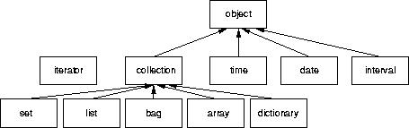
Object Inheritance Hierarchy

Slide 76
Atomic Objects
Atomic objects are user-defined objects and are defined via keyword class
An example:
class Employee (extent all_emplyees key ssn) {
attribute string name;
attribute string ssn;
attribute short age;
relationship Dept works_for;
void reassign(in string new_name);
}

Slide 77
Class Extents
An ODMG object can have an extent defined via a class declaration
Each extent is given a name and will contain all persistent objects of that class
For Employee class, for example, the extent is called all_employees
This is similar to creating an object of type Set<Employee> and making it persistent

Slide 78
Class Key
A class key consists of one or more unique attributes
For the Employee class, the key is ssn
Thus each employee is expected to have a unique ssn
Keys can be composite, e.g.,
(key dnumber, dname)

Slide 79
Object Factory
An object factory is used to generate individual objects via its operations
An example:
interface ObjectFactory {
Object new ();
};
new() returns new objects with an object_id
One can create their own factory interface by inheriting the above interface

Slide 80
Interface and Class Definition
ODMG supports two concepts for specifying object types:
Interface
Class
There are similarities and differences between interfaces and classes
Both have behaviors (operations) and state (attributes and relationships)

Slide 81
ODMG Interface
An interface is a specification of the abstract behavior of an object type
State properties of an interface (i.e., its attributes and relationships) cannot be inherited from
Objects cannot be instantiated from an interface

Slide 82
ODMG Class
A class is a specification of abstract behavior and state of an object type
A class is Instantiable
Supports “extends” inheritance to allow both state and behavior inheritance among classes
Multiple inheritance via “extends” is not allowed

Slide 83
Object Definition Language
ODL supports semantics constructs of ODMG
ODL is ndependent of any programming language
ODL is used to create object specification (classes and interfaces)
ODL is not used for database manipulation

Slide 84
ODL Examples (1) A Very Simple Class
A very simple, straightforward class definition (all examples are based on the university schema presented in Chapter 4 and graphically shown on page 680):
class Degree {
attribute string college;
attribute string degree;
attribute string year;
};

Slide 85
ODL Examples (2) A Class With Key and Extent
A class definition with “extent”, “key”, and more elaborate attributes; still relatively straightforward
class Person (extent persons key ssn) {
attribute struct Pname {string fname …} name;
attribute string ssn;
attribute date birthdate;
…
short age();
}

Slide 86
ODL Examples (3) A Class With Relationships
Note extends (inheritance) relationship
Also note “inverse” relationship
Class Faculty extends Person (extent faculty) {
attribute string rank;
attribute float salary;
attribute string phone;
…
relationship Dept works_in inverse Dept::has_faculty;
relationship set<GradStu> advises inverse GradStu::advisor;
void give_raise (in float raise);
void promote (in string new_rank);
};

Slide 87
Inheritance via “:” – An Example
interface Shape {
attribute struct point {…} reference_point;
float perimeter ();
…
};
class Triangle: Shape (extent triangles) {
attribute short side_1;
attribute short side_2;
…
};

Slide 88
Object Query Language
OQL is DMG’s query language
OQL works closely with programming languages such as C++
Embedded OQL statements return objects that are compatible with the type system of the host language
OQL’s syntax is similar to SQL with additional features for objects

Slide 89
Simple OQL Queries
Basic syntax: select…from…where…
SELECT d.name
FROM d in departments
WHERE d.college = ‘Engineering’;
An entry point to the database is needed for each query
An extent name (e.g., departments in the above example) may serve as an entry point

Slide 90
Iterator Variables
Iterator variables are defined whenever a collection is referenced in an OQL query
Iterator d in the previous example serves as an iterator and ranges over each object in the collection
Syntactical options for specifying an iterator:
d in departments
departments d
departments as d

Slide 91
Summary
Proposed standards for object databases presented
Various constructs and built-in types of the ODMG model presented
ODL and OQL languages were presented
An overview of the C++ language binding was given
Conceptual design of object-oriented database discussed

